Slide 1
Chapter 18
Futures Options and Black’s Model

Slide 2
Options on Futures
Referred to by the maturity month of the underlying futures
The option is American and usually expires on or a few days before the earliest delivery date of the underlying futures contract

Slide 3
Mechanics of Call Futures Options
When a call futures option is exercised the holder acquires
  A long position in the futures
  A cash amount equal to the excess of the futures price at the time of the most recent settlement over the strike price

Slide 4
Mechanics of Put Futures Option
When a put futures option is exercised the holder acquires
  A short position in the futures
  A cash amount equal to the excess of the strike price over the futures price at the time of the most recent settlement

Slide 5
Example 18.1
Sept. call option contract on copper futures has a strike of 320 cents per pound. It is exercised when futures price is 331 cents and most recent settlement is 330. One contract is on 25,000 pounds
Trader receives
  Long Sept. futures contract on copper
  25,000 times 10 cents or $2,500 in cash

Slide 6
Example 18.2
Dec put option contract on corn futures has a strike price of 600 cents per bushel. It is exercised when the futures price is 580 cents per bushel and the most recent settlement price is 579 cents per bushel. One contract is on 5000 bushels
Trader receives
  Short Dec futures contract on corn
  $1,050 in cash

Slide 7
The Payoffs
If the futures position is closed out immediately:
Payoff from call = F– K
Payoff from put = K – F
where F is futures price at time of exercise

Slide 8
Interest Rate Futures Options
Options on T-Bond futures (quoted as percentage of face value to the nearest 1/64 of 1%)
Options on 3-month SOFR futures or Eurodollar futures. Each one basis point in the quote represents $25
If you think interest rates will go up should you buy call or put options?

Slide 9
Potential Advantages of Futures Options over Spot Options
Futures contracts may be easier to trade and more liquid than the underlying asset
Exercise of option does not lead to delivery of underlying asset
Futures options and futures usually trade on same exchange
Futures options may entail lower transactions costs

Slide 10
European Futures Options
European futures options and European spot options are equivalent when futures contract matures at the same time as the option
It is common to regard European spot options as European futures options when they are valued

Slide 11
Put-Call Parity for Futures Options (Equation 18.1)
Consider the following two portfolios:
1. European call plus Ke^{−rT} of cash
2. European put plus long futures plus cash equal to F₀e^{−rT}
They must be worth the same at time T so that
c + Ke^{−rT} = p + F₀e^{−rT}

Slide 12
Other Relations (equations 18.2 to 18.4)
F₀ e^{−rT} – K < C – P < F₀ – Ke^{−rT}
c > (F₀ – K)e^{−rT}
p > (F₀ – K)e^{−rT}

Slide 13
Growth Rates For Futures Prices
A futures contract requires no initial investment
In a risk-neutral world the expected return should be zero
The expected growth rate of the futures price is therefore zero
The futures price can therefore be treated like a stock paying a dividend yield of r

Slide 14
Valuing European Futures Options
We can use the formula for an option on a stock paying a dividend yield
  S₀ = current futures price, F₀
  q = domestic risk-free rate, r
Setting q = r ensures that the expected growth of F in a risk-neutral world is zero
The result is referred to as Black’s model because it was first suggested in a paper by Fischer Black in 1976

Slide 15
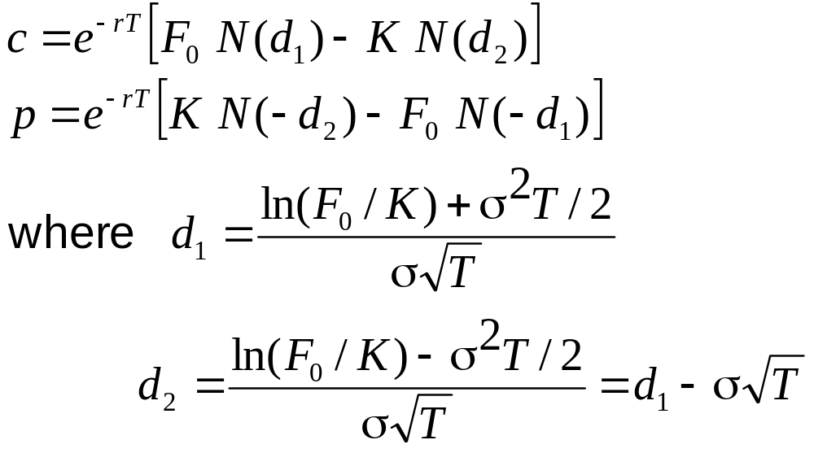
Black’s Model (Equations 18.7 and 18.8)

Slide 16
How Black’s Model is Used in Practice
Black’s model is frequently used to value European options on the spot price of an asset
This avoids the need to estimate income on the asset

Slide 17
Using Black’s Model Instead of Black-Scholes-Merton (Example 18.7)
Consider a 6-month European call option on spot gold
6-month futures price is 1,240, 6-month risk-free rate is 5%, strike price is 1,200, and volatility of futures price is 20%
Value of option is given by Black’s model with F₀ = 1,240, K=1,200, r = 0.05, T=0.5, and σ = 0.2
It is 88.37

Slide 18
Binomial Tree Example (Figure 18.1)
A 1-month call option on futures has a strike price of 29.
Futures Price = $33
Option Price = $4
Futures Price = $30
Option Price = ?
Futures Price = $28
Option Price = $0

Slide 19
Setting Up a Riskless Portfolio
Consider the Portfolio: long Δ futures short 1 call option
Portfolio is riskless when 3Δ − 4 = −2Δ or Δ = 0.8
3Δ − 4
−2Δ

Slide 20
Valuing the Portfolio
( Risk-Free Rate is 6% )
The riskless portfolio is:
long 0.8 futures short 1 call option
The value of the portfolio in 1 month is −1.6
The value of the portfolio today is −1.6e^{−0.06/12} = −1.592

Slide 21
Valuing the Option
The portfolio that is
long 0.8 futures short 1 option
is worth −1.592
The value of the futures is zero
The value of the option must therefore be 1.592

Slide 22
Generalization of Binomial Tree Example (Figure 18.2)
A derivative lasts for time T and is dependent on a futures price
F₀u
ƒ_{u}
F₀
ƒ
F₀d
ƒ_{d}

Slide 23
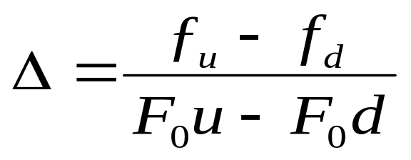
Generalization
(continued)
Consider the portfolio that is long Δ futures and short 1 derivative
The portfolio is riskless when
F₀u Δ − F₀ Δ – ƒ_{u}
F₀d Δ− F₀Δ – ƒ_{d}

Slide 24
Generalization
(continued)
Value of the portfolio at time T is F₀u Δ – F₀Δ – ƒ_{u}
Value of portfolio today is –ƒ
Hence ƒ = − [F₀uΔ − F₀Δ − ƒ_{u}]e^{−rT}

Slide 25
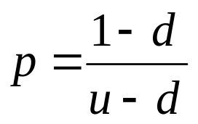
Generalization
(continued)
Substituting for Δ we obtain
ƒ = [ p ƒ_{u} + (1 – p )ƒ_{d} ]e^{–rT}
where

Slide 26
Futures Option Price vs Spot Option Price
If futures prices are higher than spot prices (normal market), an American call on futures is worth more than a similar American call on spot. An American put on futures is worth less than a similar American put on spot.
When futures prices are lower than spot prices (inverted market) the reverse is true.

Slide 27


Futures Style Options
A futures-style option is a futures contract on the option payoff
Some exchanges trade these in preference to regular futures options
The futures price for a call futures-style option is
The futures price for a put futures-style option is

Slide 28
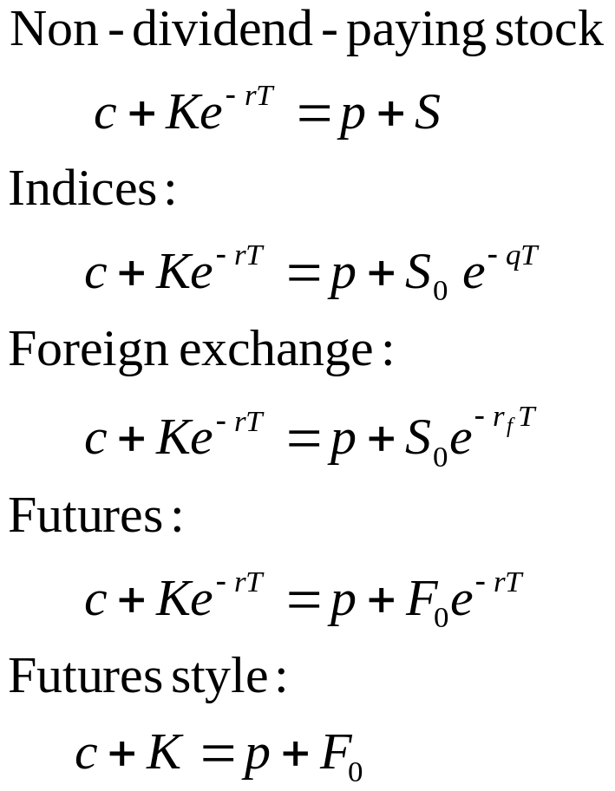
Summary: Put-Call Parity Results

Slide 29
Summary of Key Results from Chapters 17 and 18
We can treat stock indices, currencies, and futures like a stock paying a dividend yield of q
  For stock indices, q is average dividend yield on the index over the option life
  For currencies, q = r_{ƒ}
  For futures, q = r

